Slide 1
DNA Fountain Seminar Datenmanagement
Nako Nachev

Slide 2
DNA Fountain coding strategy
DNA Fountain introduction
Encoding overview
Preprocessing
Luby Transform
Random selection
Soliton distribution
Seed selection (LSFR)
Droplet creation
Screening
Oligos generation
Decoding process
Preprocessing
Droplet recovery
Segment inference

Slide 3

DNA Fountain introduction
Represents a method for decoding digital data into DNA sequences
Unlike binary data (0s and 1s), DNA Fountains utilizes the 4 nucleotide bases
Adenine (A)
Cytosine (C)
Guanine (G)
Thymine (T)
Data is saved and encoded in molecules
Each droplet corresponds to a packet of digital data
Once the bucket is full we can retain the full data

Slide 4
Preprocessing stage (Segmentation)
Preprocessing
Luby Transform
Random selection
Soliton distribution
Seed selection (LSFR)
Droplet creation
Screening
Oligos generation
Files are initially packaged (tar) and compressed using gzip
Compressed file is partitioned in non-overlapping segments of length L
In case of segments having len(segment) < L we fill the missing bits with zeroes
1 | 0 | 1 | 0 | 0 | 0 | 0 | 0| 1 | 1 | 1 | 1 |
1 | 0 | 1 | 0
0 | 0 | 0 | 0
1 | 1 | 1 | 1

Slide 5
Luby Transform (Random selection)
Preprocessing
Luby Transform
Random selection
Soliton distribution
Seed selection (LSFR)
Droplet creation
Screening
Oligos generation
Luby Transform stage is responsible for the droplet/oligo generation
It begins by randomly choosing how many segments to combine
This is achieved via the robust soliton distribution
The “combination” of segments is achieved by XOR-ing (Bitwise addition mod 2) the individual segments

Slide 6
Luby Transform (Robust Soliton Distribution)
Preprocessing
Luby Transform
Random selection
Soliton distribution
Seed selection (LSFR)
Droplet creation
Screening
Oligos generation
Upon generation of the distributions – a random choice n is taken
Example:
N = 3
We pick 3 segments at random without replacement
Segments : [1,0,0,1], [0,0,0,0], [1,1,0,0]
Apply bitwise addition: 1001 Ꚛ 0000 Ꚛ 1100 = 0101
The result 0101 is passed to the next stage

Slide 7
Luby Transform (LFSR)
Preprocessing
Luby Transform
Random selection
Soliton distribution
Seed selection (LFSR)
Droplet creation
Screening
Oligos generation
The XOR-ed segments alone are not enough for the droplet generation and later on for the decoding process
A seed needs to be generated using the Linear Feedback Shift Register (LFSR)
A LFSR works the following way:
Take an n-bit binary integer (initial state)
Define a primitive polynomial for the LFSR
Start endlessly transforming it:
Step 1: Shift the numbers to the right
Step 2: Use the predetermined polynomial to calculate the leftmost bit
Step 3: The polynomial determines the so-called “taps”, which are the coefficients of the polynomial
Step 4: XOR the bits under the tap positions to get the leftmost bit
Step 5: Repeat the process
Given the right polynomial a LFSR will cycle out all possible n-bit combinations till we reach the initial state

Slide 8
Luby Transform (LFSR example)
Preprocessing
Luby Transform
Random selection
Soliton distribution
Seed selection (LFSR)
Droplet creation
Screening
Oligos generation
Initial state for 3-bit integer: 100
Polynomial = x^2 + x + 1
This result in having taps (2,1), therefore we XOR the bits on positions 2 and 1 on each cycle
cycle | b1 | b2 | b3
- | 1 | 0 | 0
1 | 0 | 1 | 0
2 | 1 | 0 | 1
3 | 1 | 1 | 0
4 | 1 | 1 | 1
5 | 0 | 1 | 1
6 | 0 | 0 | 1
7 | 1 | 0 | 0
Each state corresponds to a new seed
The seed is then attached to the front of the bitwise addition of the segments
b1 = 0 Ꚛ 0 = 0
b1 = 1 Ꚛ 0 = 1
b1 = 0 Ꚛ 1 = 1

Slide 9
Luby Transform (Droplet creation)
Preprocessing
Luby Transform
Random selection
Soliton distribution
Seed selection (LFSR)
Droplet creation
Screening
Oligos generation
After the seed is attached to the bitwise addition result, we have the droplet formation
Example: seed 10, bitwise addition result 1010 -> droplet is 101010
Since the droplet has to synthesized, we need to convert it to DNA first
Mapping:
00: A
01: C
10: G
11: T
Therefore producing GGG
On demand a RS Code can be attached to the end for error correction
GGGACCG
10101000010110
Seed
Payload
RS-Code

Slide 10
Screening stage
Preprocessing
Luby Transform
Random selection
Soliton distribution
Seed selection (LFSR)
Droplet creation
Screening
Oligos generation
Not part of the original fountain code design
Allows us to complete realize the coding potential of each nucleotide
The created droplet is against 2 conditions:
Condition 1: Long homopolymer runs (e.g. AAAAAA…)
Condition 2: High “GC” content
Both of the above mentioned conditions are undesirable
Difficult to synthesize
Prone to sequencing errors
If any of the both conditions is met – droplet is dropped and process starts from the beginning

Slide 11
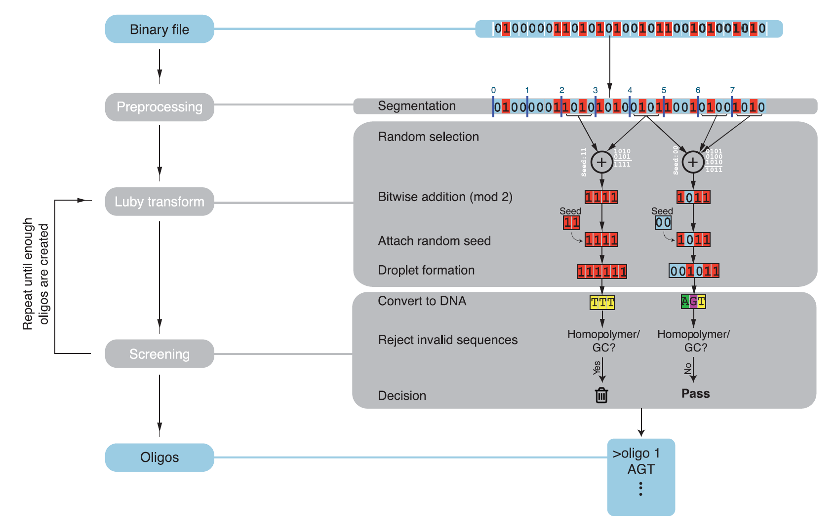
Oligo creation
Preprocessing
Luby Transform
Random selection
Soliton distribution
Seed selection (LFSR)
Droplet creation
Screening
Oligos generation
After the screening stage is complete we receive the final oligo
The process of Luby Transform and Screening is repeated until sufficient number of valid oligos is generated (usually 5 to 10% more oligos than input segments)

Slide 12
Decoding (preprocessing)
Preprocessing
Droplet recovery
Segment inference
The process of oligo generation can generate many oligos
The ones with length > X (predefined) are filtered out
Most of them could be identical
Identical sequences are collapsed and the number of occurrences is stored
Sequences are sorted so that prevalent sequences appear first
Highest quality data first
We might not need all oligos, so singletons are placed at the end

Slide 13
Decoding (preprocessing example)
Preprocessing
Droplet recovery
Segment inference
Generated oligos: GAT, TAG, CAG, GTC, GAT, AAG, GAT, GGAT, CAG
GGAT is dropped (length > 3 nucleotides)
Calculate occurrences: GAT: 3, TAG: 1, CAG: 2, GTC: 1, AAG: 1
Sort: GAT:3, CAG: 2, TAG: 1, GTC: 1, AAG: 1

Slide 14
Decoding (droplet recovery)
Preprocessing
Droplet recovery
Segment inference
Translate the DNA sequence into binary format
{A,C,G,T} to {0,1,2,3} or {00, 01, 10, 11}
Extract seed, data payload and RS Code (if exists)
Given sequence = [….]
Seed = [: seed_size]
Data = [seed_size: segment_size]
RS Code = [(seed_size + segment_size):]
If error correcting code available, check if there are any errors
Sequences with 1 or more errors are excluded
Most errors due to short insertions/deletions from oligo synthesis
Attempting to correct is more likely to result in erroneous recovery

Slide 15
Decoding (Segment inference)
Preprocessing
Droplet recovery
Segment inference
Assumption: integrity of binary message is validated
Initialize the pseudorandom number generator with the observed seed
Generate a list of input segment identifiers
These segment identifiers are the likely positions of segments that were XOR-ed together to form the droplet
Example: droplet X was generated with 3 segments – the LFSR generates indices [3, 20, 5]
Employ one round of message passing algorithm
If any of the indices in the droplet were already inferred
XOR them and remove from the droplet list of indices
If the droplet has only one element left:
Set the segment to the droplets data payload
The process is repeated until no more updates can be made

Slide 16
Benchmark test and considerations
Both of the inputs were decoded to match 100%
A third really small one (16 bits in total) example was used for testing purposes
Parameters play a crucial role
Segment size
Initial seed and chosen polynomial for the LFSR
Multiplier for oligos to generate
For example multiplier of 5 means generate 5 times as many oligos as there were segments
Homopolymer and GC content criterias
Soliton parameters (c and delta)
Computational speed
Testing machine
Single/Multithreaded environment
Algorithm optimization

Slide 17
Benchmark testing configs/conditions
Minimal Input
Segment size = 4
Initial seed = [1,0,0,0]
Polynomial: x^4 + x^3 + 1
Segments multiplier = 5
Robust Soliton
C = 0.1
Delta = 0.001
K = len(segments)
Short Input
Segment size = 32
Initial seed = [1….0] (32 bit)
Polynomial: x^32 + x^30 + x^26 + x^25+ 1
Segments multiplier = 3.5
Testing PC
CPU: i9 13900HX
RAM: 64 GB 5200 MHz
Long Input
Segment size = 4
Initial seed = [1….0] (32 bit)
Polynomial: x^32 + x^30 + x^26 + x^25+ 1
Segments multiplier = 3

Slide 18
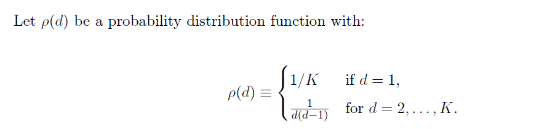
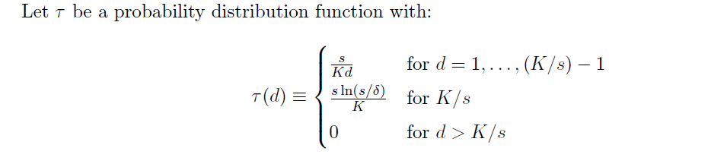
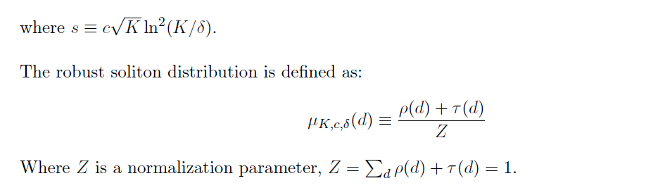
Luby Transform (Robust Soliton Distribution)
Preprocessing
Luby Transform
Random selection
Soliton distribution
Seed selection (LSFR)
Droplet creation
Screening
Oligos generation
Ideal soliton dist.
Robust soliton dist.

Slide 19
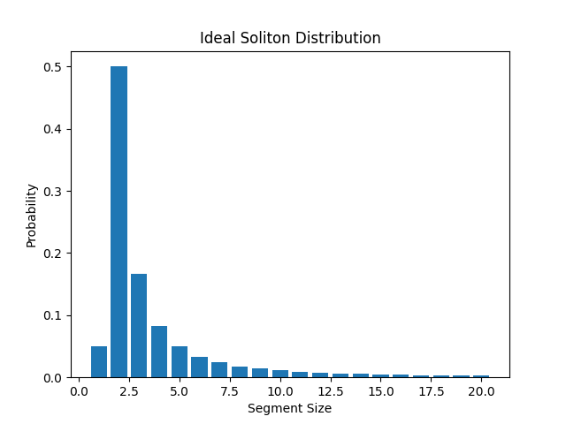
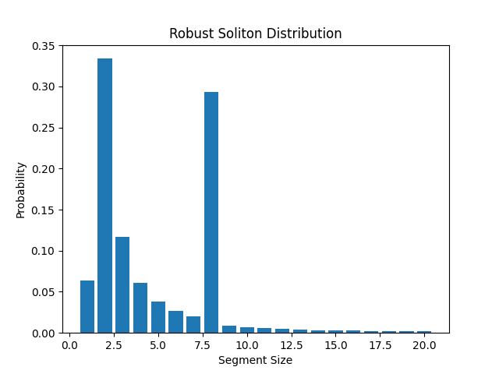
Luby Transform (Robust Soliton Distribution)
Preprocessing
Luby Transform
Random selection
Soliton distribution
Seed selection (LSFR)
Droplet creation
Screening
Oligos generation
Values used: K = 20, c = 0.5, delta = 0.001

